Slide 1

When Life Insurance Gets Interesting

Slide 2

Advisers need our help!
Some HNW advisers employ underwriters
Some advisers use pre-sales tools and helplines
Some advisers signpost to others
Some advisers get more coffee
Some advisers go online…

Slide 3
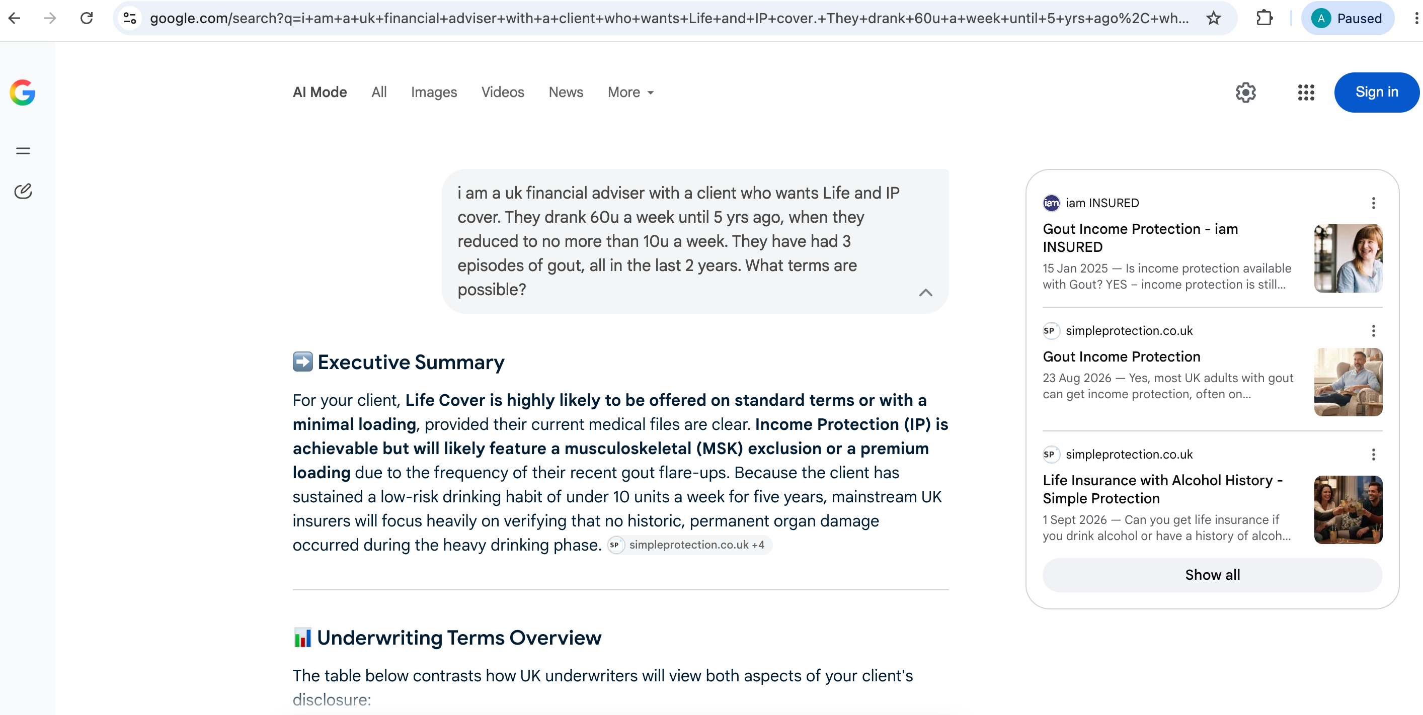

Slide 4
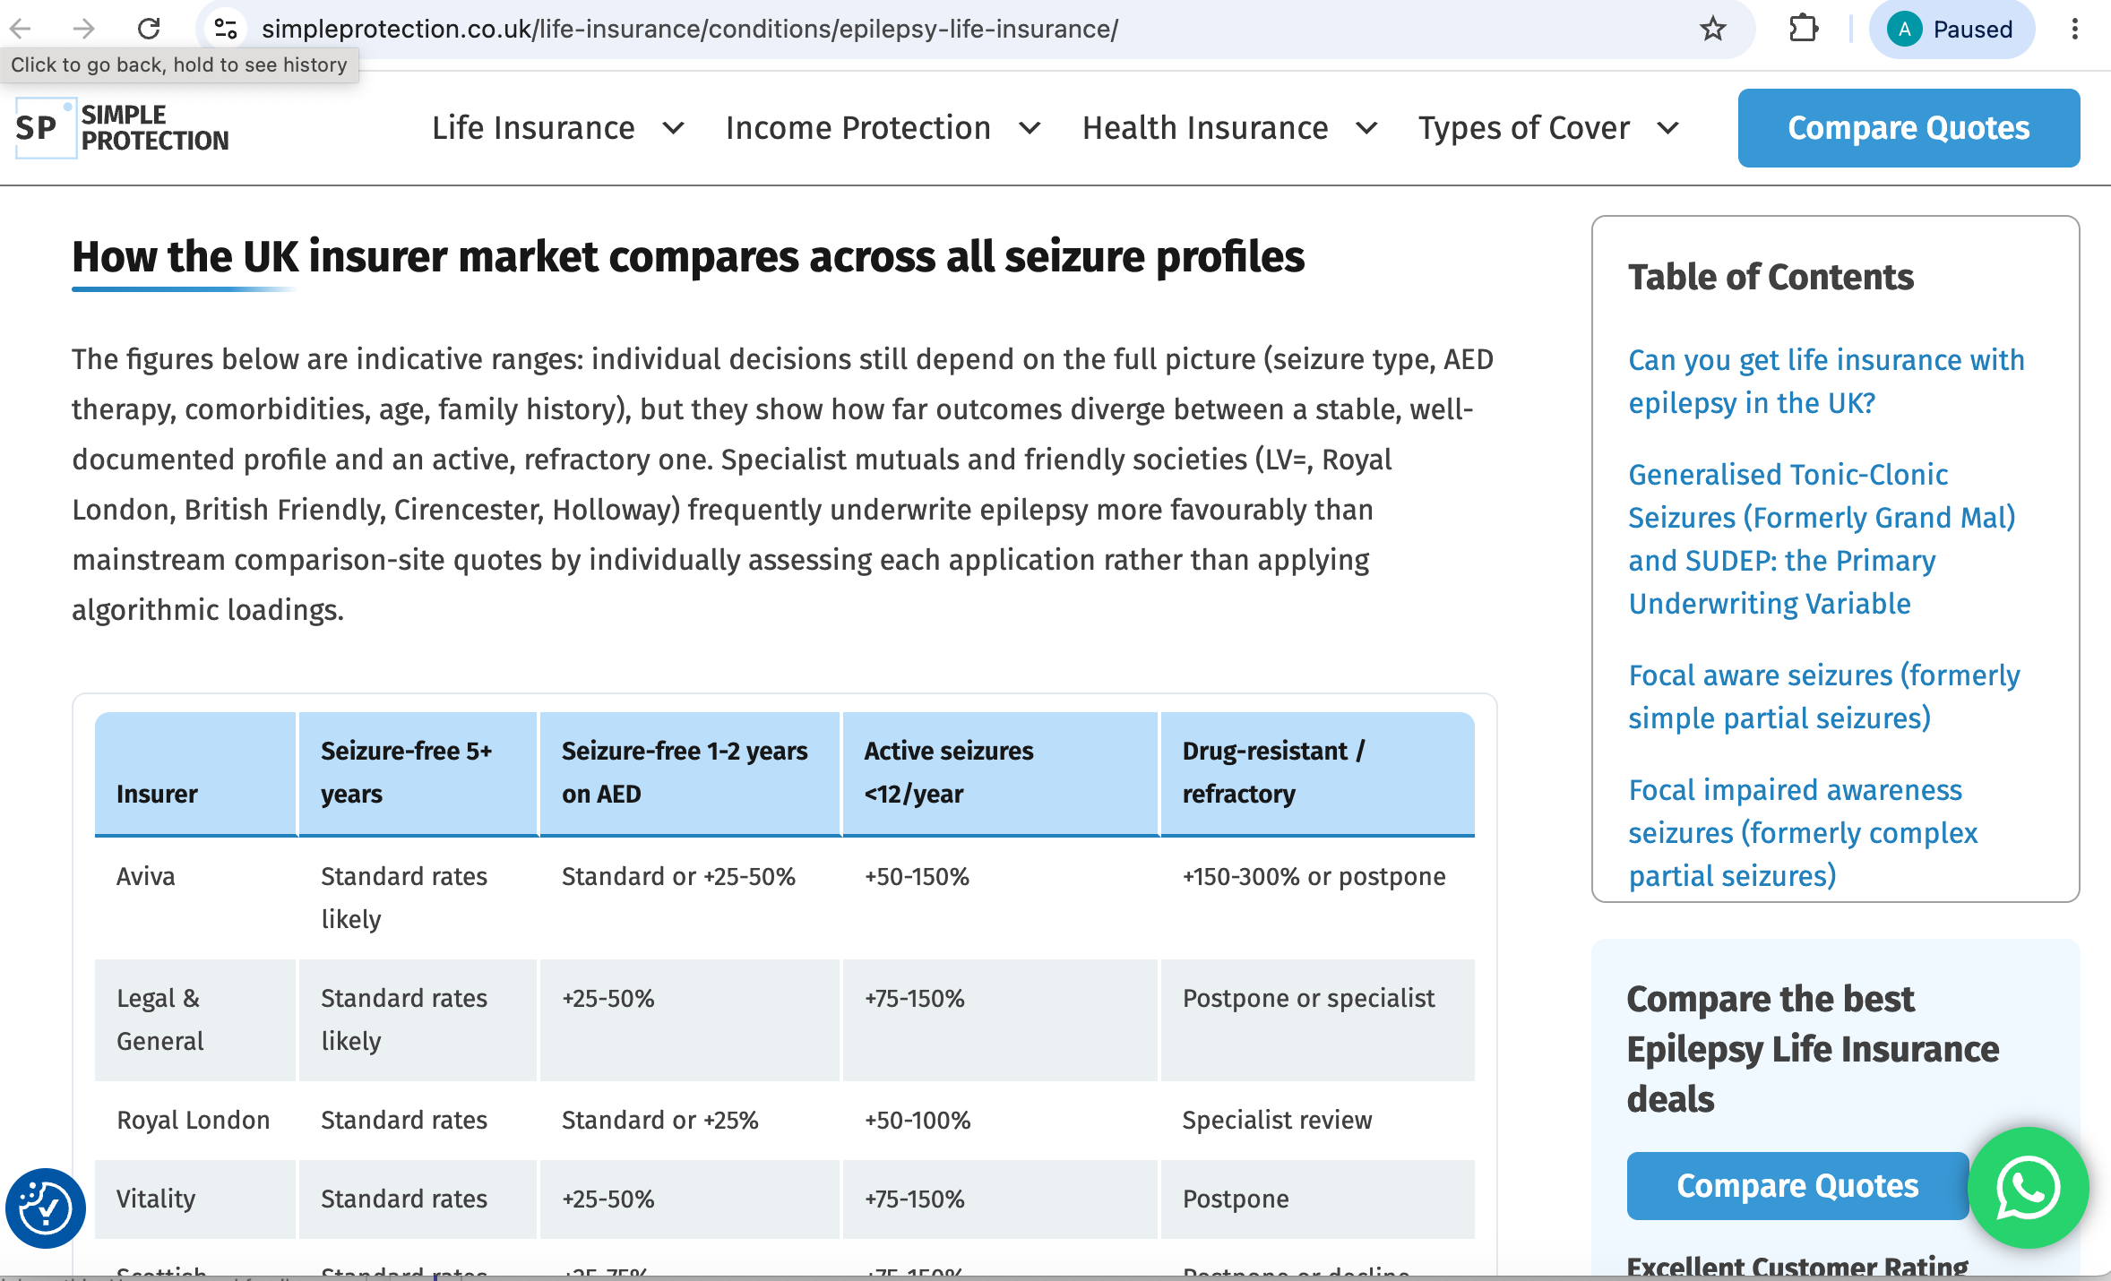

Slide 5

An underwriter in a pocket
Reducing adviser fears
Giving accurate information on likely outcomes
Enabling quick answers at points of uncertainty
Providing general market information for all questions
Supplying insurer specific information for BMI and NMLs today

Slide 6
How do we do it?
Prompts, sweat, blood, trial and error
Combination of Retrieval Augmented Generation and guided sources
  Providing some fixed, structured information
  Pointing to approved websites
  Focussing on UK information
  Reducing influence marketing materials can have
Restricting scope of answers that can be given
  At present no opinions on which insurer is “best”
  Only protection insurance questions answered

Slide 7
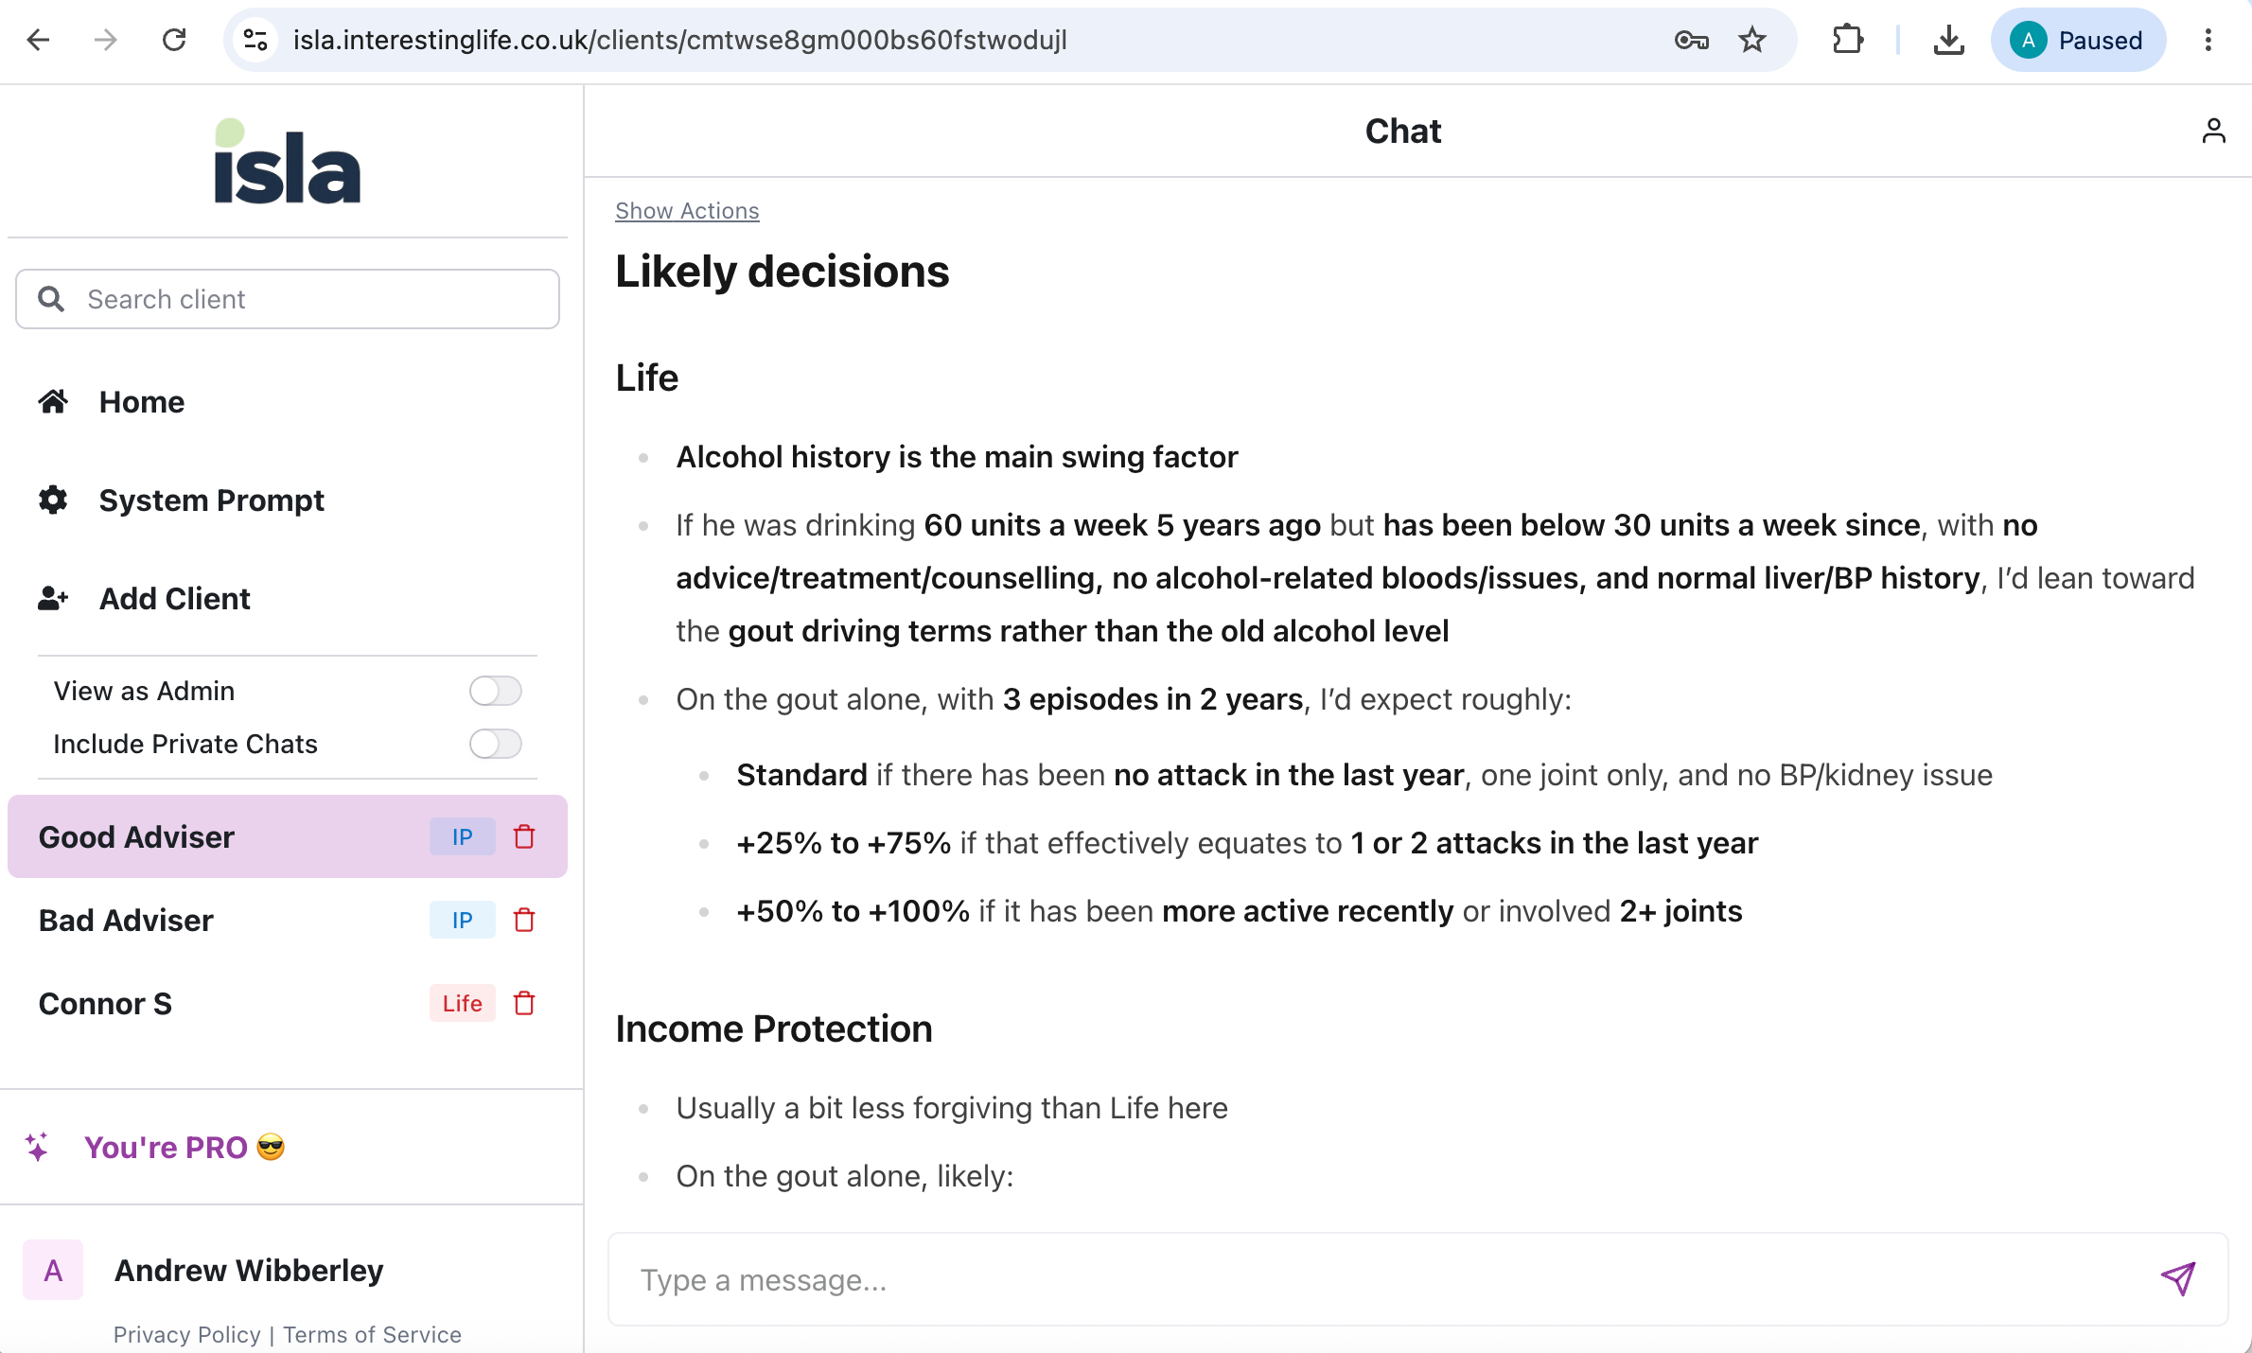

Slide 8
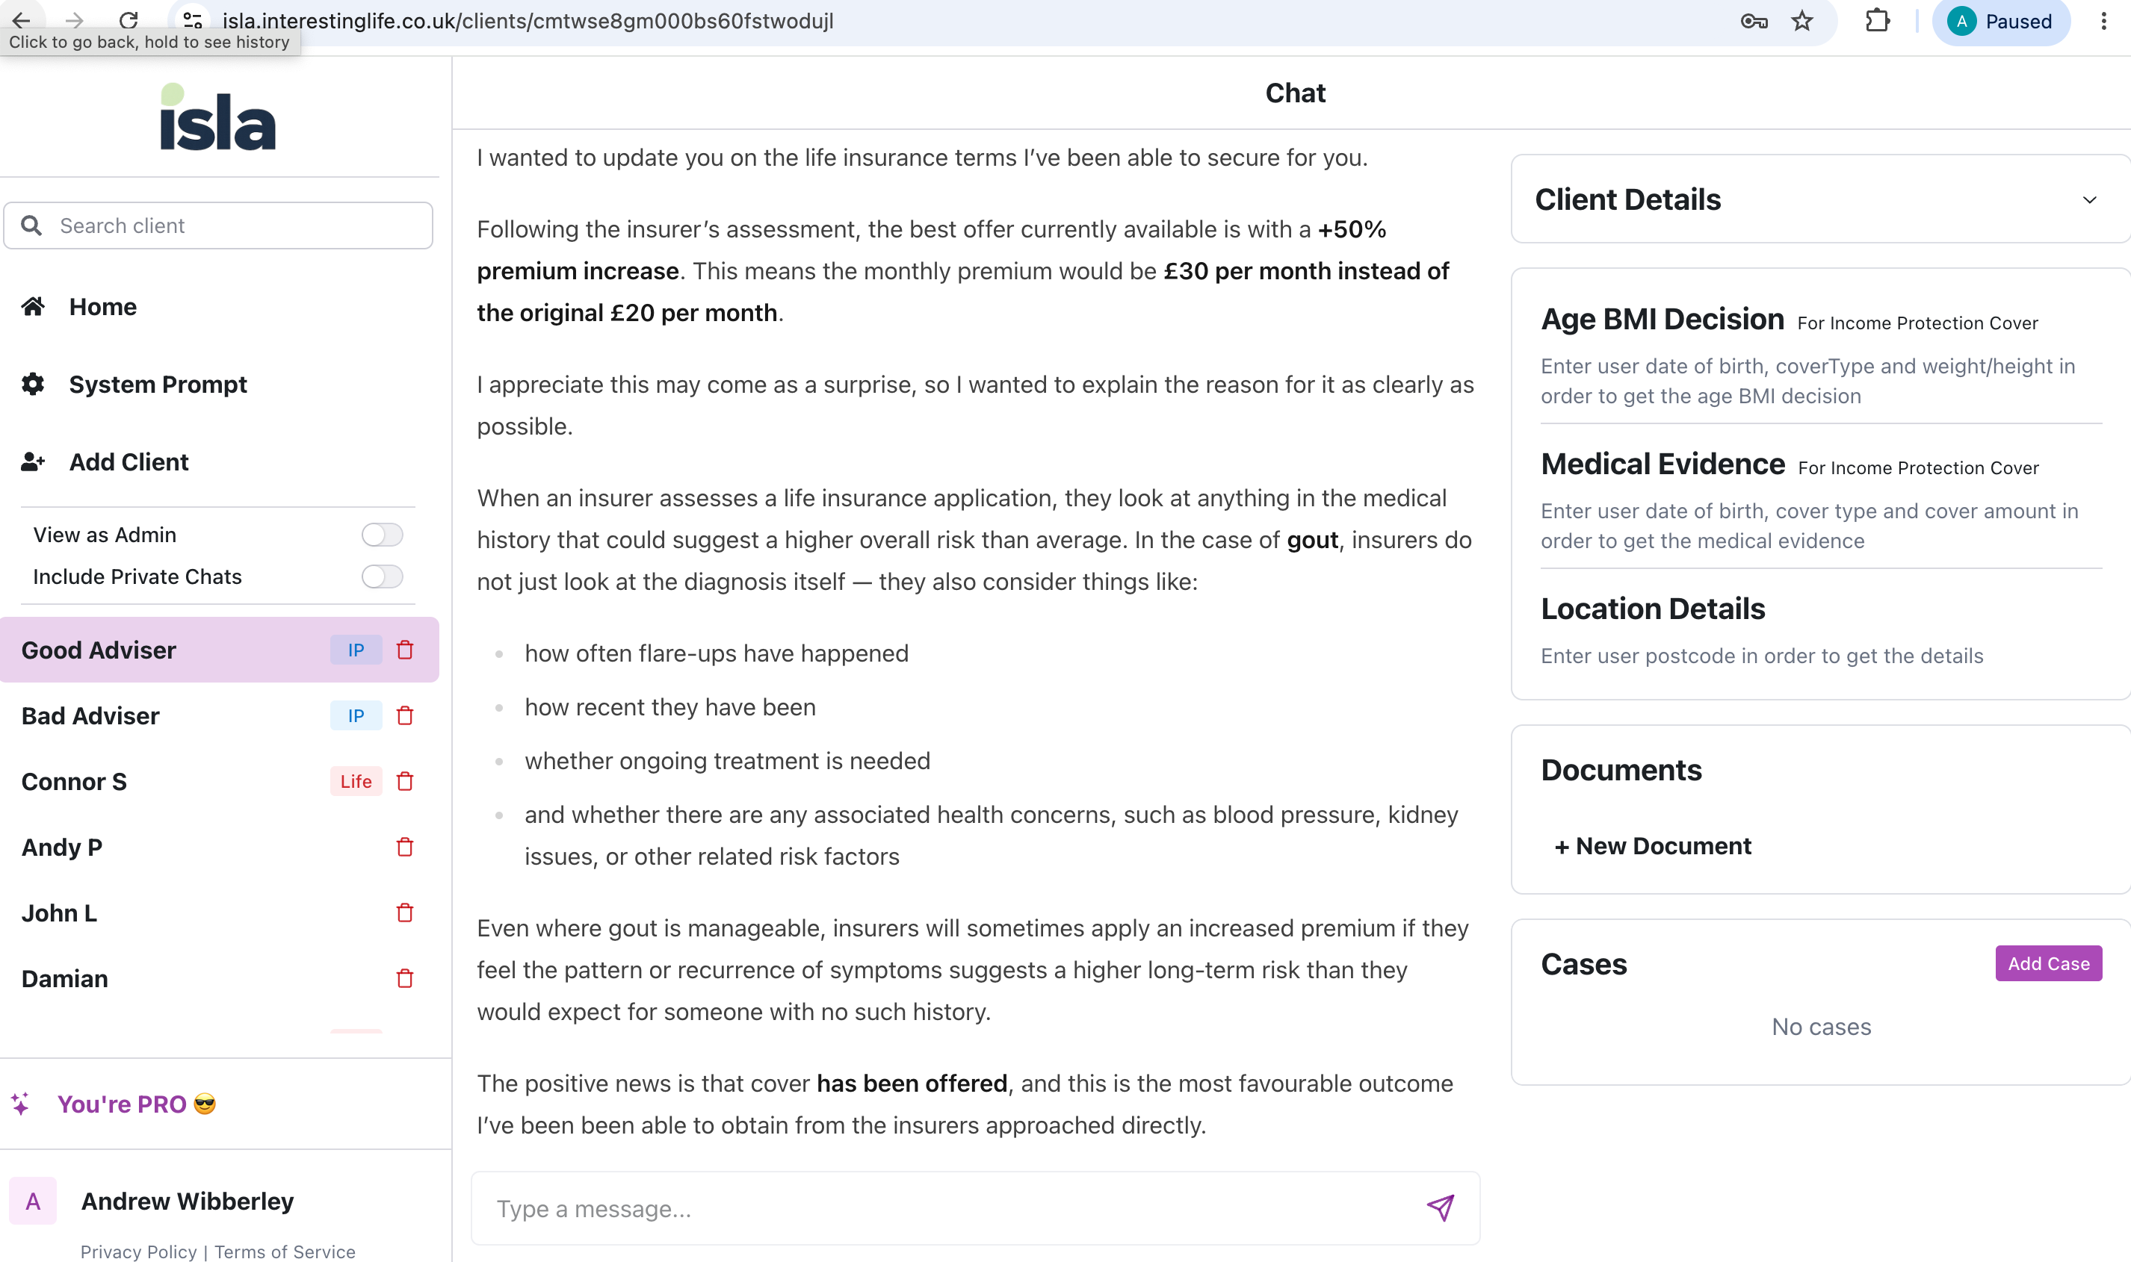

Slide 9

Coming soon (from someone in this room or outside?)
Advisers / networks using decisions received from insurers to predict future outcomes
Upload your GP records / specialist letters and get immediate pre-sales indication
Upload your GP records / specialist letters and pre-fill parts of application form
Upload your GP records and ask any outstanding information in natural way to complete application

Slide 10
What you can do to help yourselves
Have a play, and a look at what there already is out there
Get your BDMs to ask advisers what tools they currently use and how they use them
Consider what you make available on the web to perform as you wish in these responses
Think about the operational risk issues of more research being done away from your understanding and monitoring

Slide 11
What you could do to help us
Try ISLA and let us know what you think
Point us towards underwriting information that you are happy to share with all advisers
Talk with us about ways you could share more information to help get more interesting lives insured

