Slide 1

Beyond the Diagnosis: Modern Cancer Treatment and Insurance Risk !
New Cancer Outcomes:
Progress, Problems and Promise
Stephen Falk, Oncologist, Bristol
September 2026

Slide 2
New Cancer Outcomes:
Progress, Problems and Promise
Pancreas cancer
Melanoma
Lung Cancer
Breast cancer
Prostate Cancer
Changes in treatment
Changes in outcome
  Survival
  Survivorship

Slide 3
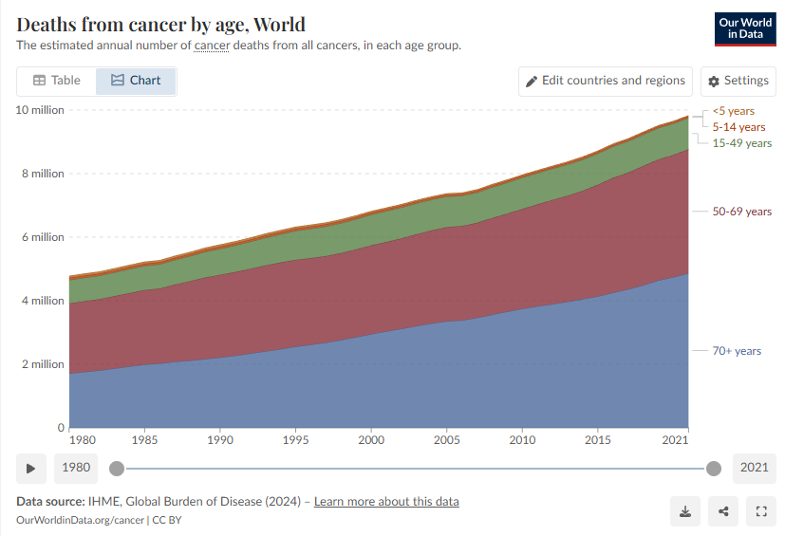
Deaths from cancer by age
Data source: IHME, Global Burden of Disease (2024)
https://ourworldindata.org/cancer

Slide 4
Some cancers have done better than others
What proportion of patients live more than 5 years following a diagnosis of cancer ?
15-25%
35-45%
55-65%
75-85%

Slide 5
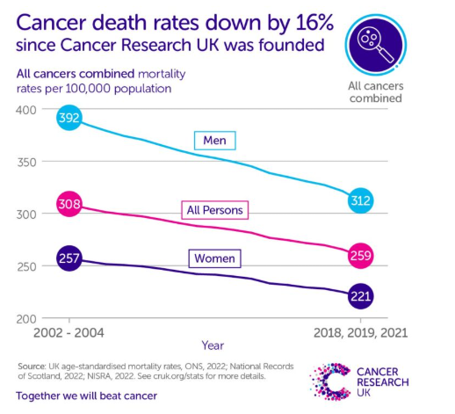
Improvements in outcome
The five-year survival of all patients diagnosed in 2016
was 55.7%, a 7.8 % improvement since 2005.
For example, death rates from stomach cancer
have fallen around 50%.
The number of people with lung cancer that survive
their disease for 5 years has doubled to around 20%
since the mid-2000s.
Prevention
Screening
Better treatments
CRUK website

Slide 6
Some cancers have done better than others
What proportion of patients live more than 10 years following a diagnosis of pancreatic cancer ?
<10%
10-20%
20% +
50% +

Slide 7
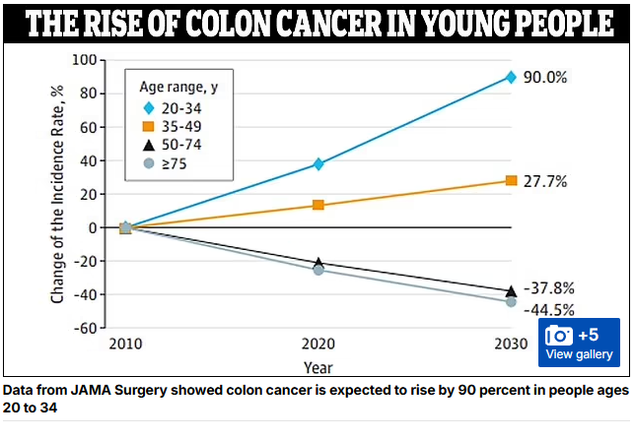

Slide 8
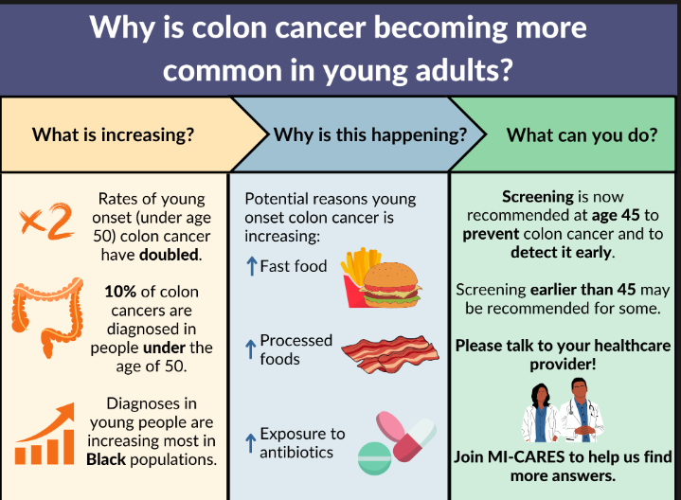
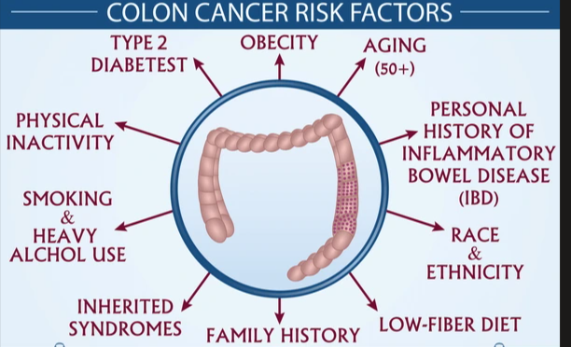
PKS-positive E. coli is thought to be present in up to one in five people, and one 2022 study found an association between the presence of the bacteria in colorectal cancers and western-style diets.
A 2020 study published in the journal Nature suggested a person's chance of developing bowel cancer may increase after becoming infected with this specific type of E.coli.

Slide 9
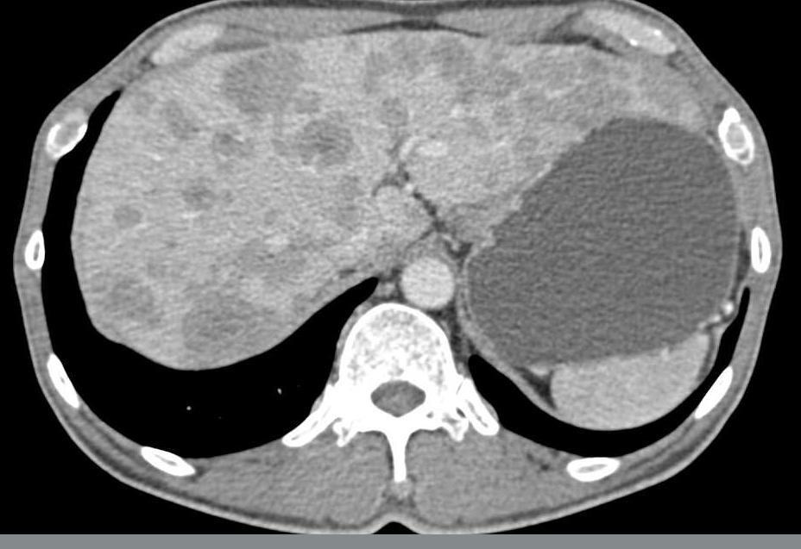
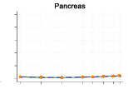
No meaningful progress in pancreas cancer
10 year cancer specific survival
in UK from 1971 to 2018
Lancet 2025 56: 101385
Previously fit 65-year old male presents with weight loss, sickness, jaundice
and rapid decline over 6 weeks
CT Multiple liver metastases and gastric outlet obstruction
Attempted insertion of stent to relieve gastric outlet obstruction failed
Died at 4 weeks following admission

Slide 10
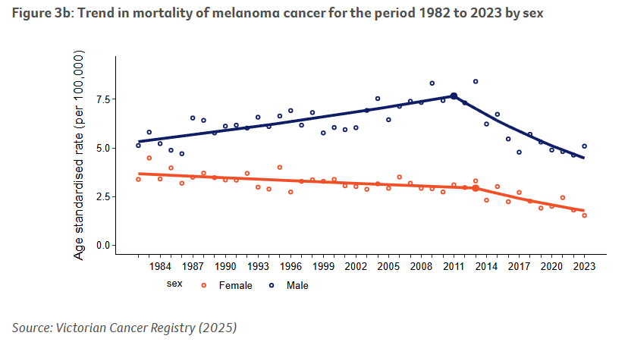
Melanoma

Slide 11
Melanoma
Survival stage IV disease in 2004 was <10%
What is the 5-year survival of metastatic melanoma post combination immunotherapy
10-25%
25-50 %
>50%

Slide 12
Melanoma Legal case
18/01/2022. 32 year old female attends GP with new black lesion on arm, reassured ‘freckle’
22/04/22 Reattends ‘its getting bigger and itchy’, reassured ‘inflamed’
29/08/22 Reattends with bleeding from mole
29/08/22 2 week wait cancer referral
Diagnosis BRAF wild type stage IV disease with liver and lung and nodal metastases
Treatment: nivolumab plus ipilimumab
Complete response

Slide 13
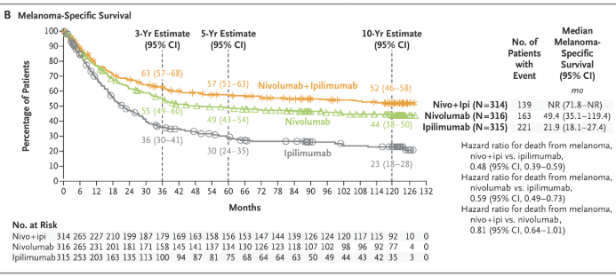
Melanoma
Wolchok et al NEJM 2025 392: 11-22
Among patients who had been alive and progression-free at 3 years,
10-year melanoma-specific survival was
96% with nivolumab plus ipilimumab,
97% with nivolumab and
88% with ipilimumab.

Slide 14
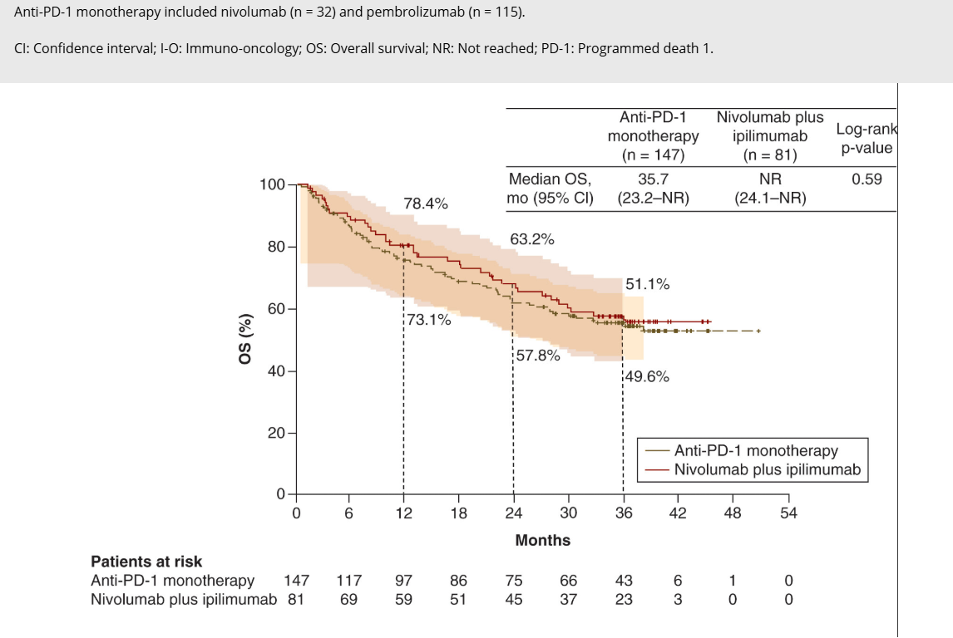
Melanoma – real world data
OPTIMIzE Registry 2023

Slide 15
Lung cancer
Molecular/genetic testing has significantly improved outcome for what proportion of stage IV lung cancer cases
<10%
20-30%
30-50%
50-100%

Slide 16
Case study
54 ♀ presented with cough and breathlessness
02/2018 R pneumonectomy T2N0M0 adenocarcinoma
03/2021 Right arm weakness – solitary brain metastasis surgery
04/2021 ALK mutation starts Crizotinib
05/2023 Local recurrence – tingling in fingers SRS Alectenib
06/2024 ? Progression on scan – surgery – post RT necrosis
03/2026 Remains in remission asymptomatic, driving licence reissued, intermittent drug holidays when Liver function and renal function worsen on treatment

Slide 17
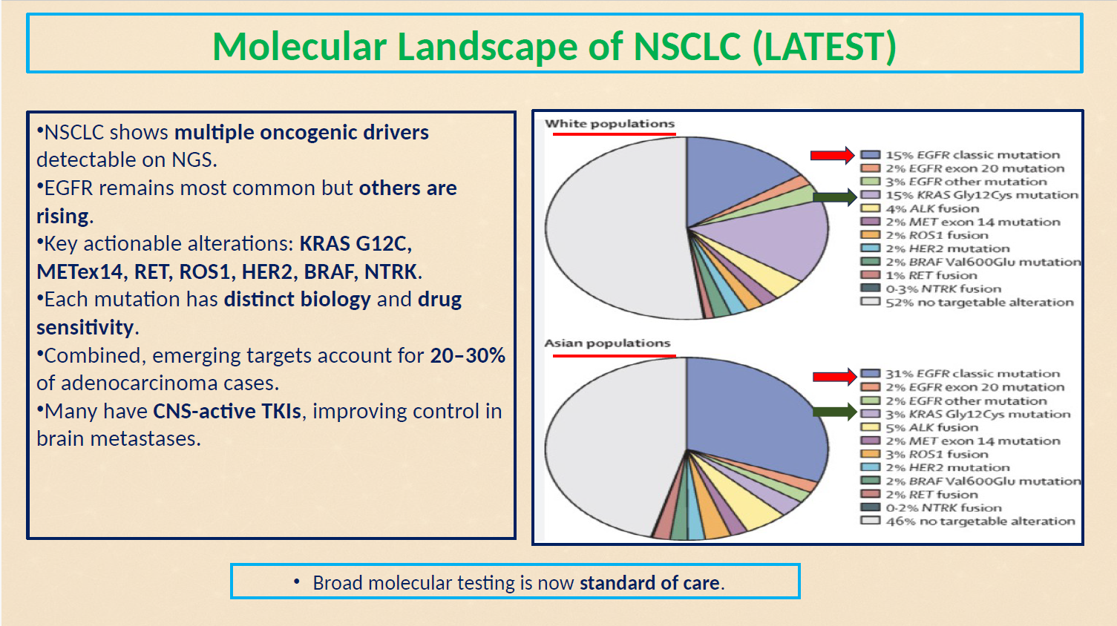
Molecular landscape of NSCLC (latest)
NSCLC shows multiple oncogenic drivers detectable on NGS.
EGRG remains most common but others are rising.
Key actional alterations: KRAS G12C, METex14, RET, ROS1, HER2, BRAF, NTRK
Each mutation has distinct biology and drug sensitivity.
Combined, emerging targets account for 20-30% of adenocarcinoma cases.
Many have CNS-active TKIs, improving control in brain metastases.
Broad molecular testing is now standard of care.

Slide 18
Targets can influence outcome
ALK-positive lung cancer median survival rates reaching 6.8 years
EGFR Mutant median survival rates 25.8 to 44.2 months
PDL1 (>50%) high disease median survival rates 30 months
Driver | Targeted Therapy | ORR (%) | Median PFS | Median OS | Notes
KRAS G12C | Sotorasib / Adagrasib (2L) | 28 - 43% | -5.5 – 6.8 mo | -10 – 12 mo | Used after chemo-IO; 1L trials ongoing
MET exon 14 | Capmatinib / Tepotinib | 40 – 68% | -8 – 12 mo | -17 – 20 mo | Strong CNS activity
RET fusion | Selpercatinib / Pralsetinib | 60 – 85% | -20 - 25 mo | -30+ mo | LIBRETTO-431 (1L) shows major benefits
NTRK fusion | Larotrectinib / Entrectinib | 57 – 75% | -11 – 24 mo | Often >30 mo | Deep, durable responses; tumor-agnostic
BRAF V600E | Dabrafenib + Trametinib | 63 – 64% | -9.7 -11 mo | -18 – 24 mo | FDA-approved based on Phase II
HER2 mutation (ex20) | Trastuzumab deruxtecan (T-DXd) | 50 – 55% | -8 – 9 mo | -17 – 18 mo | Works only in HER2-mutant (not amplified)

Slide 19
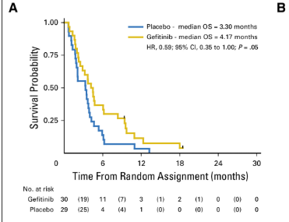
Better targeted therapies have not always become standard practice in rare cancers
Oeosphageal cancer and EGFR
Cancer Esophagus Gefitinib trial.
Conducted to compare efficacy of gefitinib with that of placebo. In EGFR FISH-positive tumours (20.2%), overall survival was improved with gefitinib compared with placebo (hazard ratio [HR] for death, 0.59; 95% CI, 0.35 to 1.00; P = .05)
J Clin Oncol 35, 2279-2287(2017)

Slide 20
Survivorship
A cancer survivor is anyone who has received a diagnosis of cancer, no matter where they are in their treatment or life journey. That means that a cancer survivor may have been just recently diagnosed, in the middle of active treatment, continuing to receive care that will help them live better and longer, or had a history of cancer and are no longer receiving any treatment
Managing long term effects of cancer and its treatment
Coping with emotional and social changes
Maintaining overall health and quality of life
Highly individual – person living with cancer

Slide 21
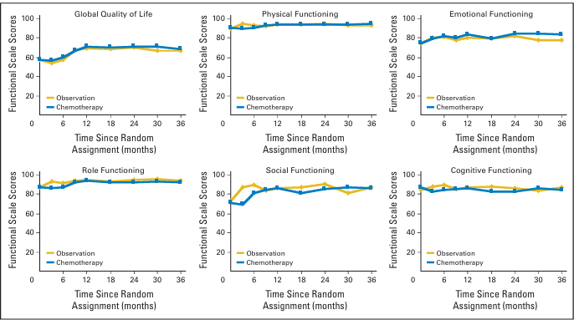
Quality of life post op chemotherapy vs nil Lung cancer
An improvement at 3months in role
Functioning for patients randomly assigned
to observation arm
A small deterioration for patients in
chemotherapy arm;
Both were significant changes from baseline,
and the Difference between arms was
significant
No significant change for observation arm;
gradual improvement in role functioning
for patients randomly assigned to
Chemotherapy arm;
Difference in the rate of change
between arms was not significant
J Clin Oncol 26:5052-5059. 2008

Slide 22
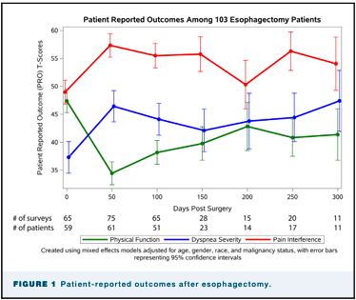
Recovery of Patient-reported Quality of Life After Oesophagectomy
‘Considerable declines in QOL scores immediately after oesophagectomy with recovery lasting nearly a year’
Ann Thorac Surg 2023;115:854-61

Slide 23
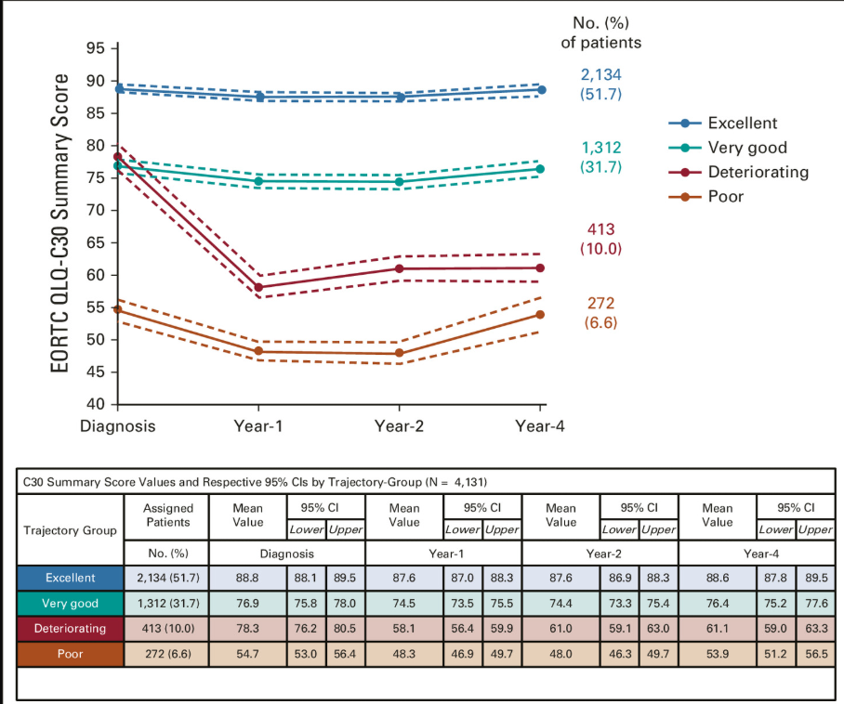
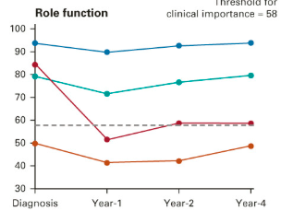
Recovery of Patient-reported Quality of Life After Breast Cancer Treatment
Healthy behaviours were associated with better performing trajectory groups. Eg deteriorating group associated with:
Obesity (adjusted odds ratio [aOR] v lean, 1.51
current smoking (aOR v never, 1.52 [95% CI, 1.27 to 1.82];
Excess body weight and insufficient physical activity through year-4
Frequent exposure to tobacco smoking during chemotherapy. Younger age (aOR, 1-year decrement 1.01 ),
Comorbidities (aOR v no, 1.22)
Lower income (aOR v wealthier households, 1.21)
Endocrine therapy (aOR v no, 1.14).
J Clin Oncol 40, 3190-3204(2022)

Slide 24
Fatigue
A persistent, overwhelming tiredness caused by cancer or its treatment that is not relieved by rest or sleep
More than 80% of people with cancer experience fatigue while receiving chemotherapy or radiation therapy
Poorly studied – only evidence-based intervention is exercise
Increasing attention being paid by charities to ‘living well with cancer’

Slide 25
Cancer and employment
Considered a disability under the Equalities Act 2010
Recovery time is not just physical
Surgery quickest recovery, slowest is chemotherapy
Chronic treatments eg hormonal for breast and prostate impair function

Slide 26

Personalised care and improving quality of life outcomes – NHS National Cancer Plan
Providing personalised care and support planning and interventions, including delivering more and better cancer services in the community
Extending personalised stratified follow up care, including patient initiated follow-up, to all appropriate cancer pathways
Reducing the impact of cancer and its treatment, including improving support for people’s psychosocial needs, encouraging physical activity across the cancer pathway and prehabilitation and rehabilitation services.

Slide 27
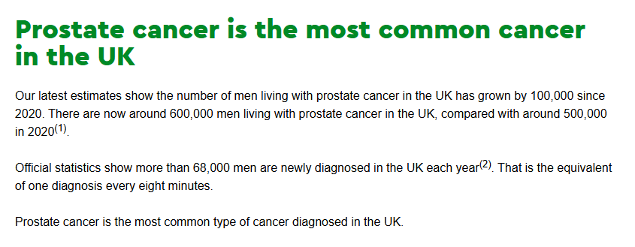
Prostate Cancer Claims
Full payout definitions typically require a histological Gleason score greater than 6, or a clinical TNM classification of T2N0M0 or greater
Problem the ‘clinical’ staging has changed

Slide 28
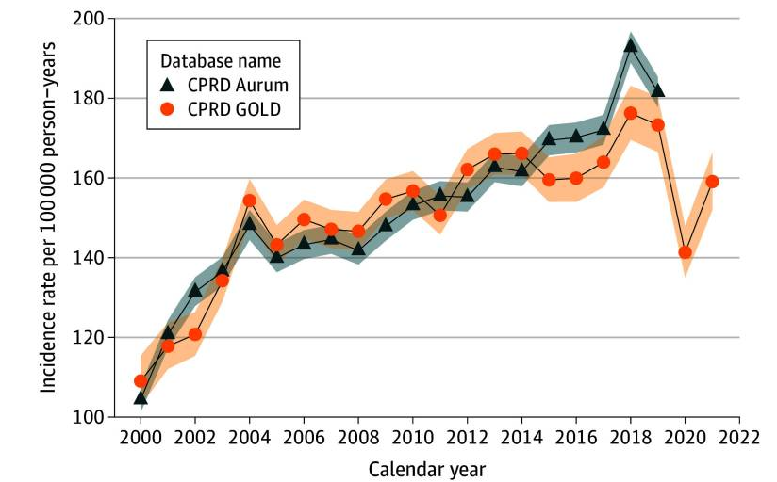
Prostate Cancer
In one cohort study of 198 125 patients
In 2 UK databases, the incidence of prostate cancer increased from 109 per 100 000 person-years in 2000 to 159 per 100 000 person-years in 2021.
Prevalence increased from 0.4% in 2000 to 1.4% in 2021.

Slide 29
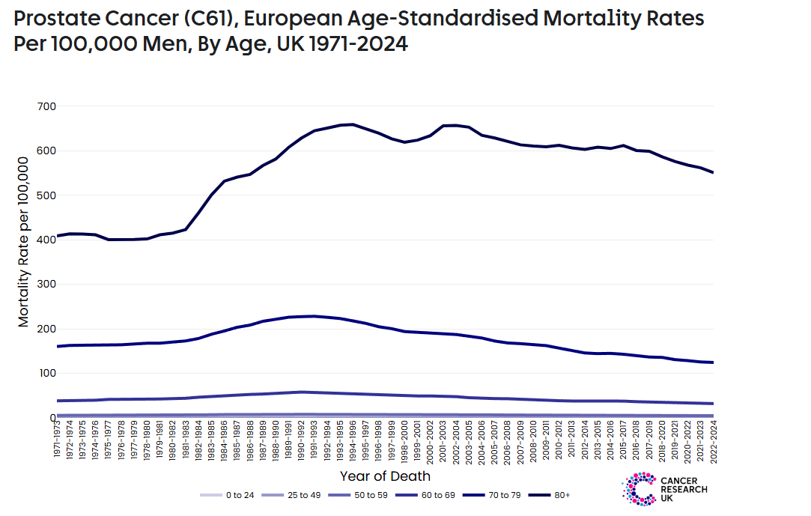
But mortality rates are stable

Slide 30
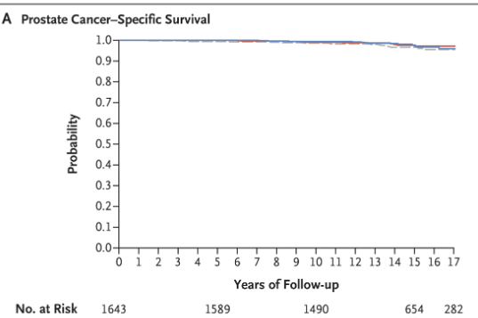
PROTECT study
Compared active monitoring, radical prostatectomy, and external-beam radiotherapy for the treatment of clinically localized prostate cancer

Slide 31
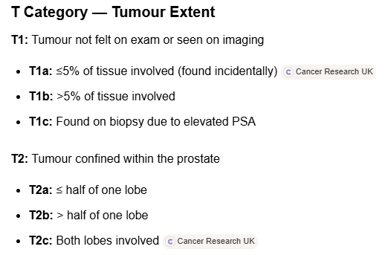
AJCC 2018 staging system Prostate Cancer
Previously T2=palpable disease
Now much more common staged clinically on radiology
The definition is outdated

Slide 32
Cambridge Prognostic Group (CPG)
Classification method used to categorize prostate cancer based on its risk of growth and spread. The CPG system is recommended by the National Institute of Health and Care Excellence (NICE) for classifying men with a new diagnosis of prostate cancer. The CPG system is used to help doctors decide which treatment options are suitable to the patient based on their risk.
The five CPG categories are described below:
CPG1: The cancer is likely to grow very slowly and very unlikely to spread.
CPG2: The cancer is likely to grow slowly and is unlikely to spread.
CPG3: The cancer is more likely to grow and spread outside the prostate.
CPG4: The cancer is more likely to grow and spread outside the prostate.
CPG5: The cancer is likely to grow quickly and spread to other parts of the body.

Slide 33
Cambridge Prognostic Group 1 (CPG 1)
You have:
Grade Group 1 (previously called a Gleason score of 6)
and a PSA level less than 10 nanograms per millilitre (ng/ml)
and a T stage of 1 or 2
Cambridge Prognostic Group 2 (CPG 2)
You have:
Grade Group 2 (previously called a Gleason score of 3 + 4 = 7)
or a PSA level between 10 and 20 ng/ml
and a T stage of 1 or 2
Cambridge Prognostic Group 3 (CPG 3)
You have:
Grade Group 2 (previously called a Gleason score of 3 + 4 = 7)
and a PSA level between 10 and 20 ng/ml
and a T stage of 1 or 2
Or
Grade Group 3 (previously called a Gleason score 4 + 3 = 7)
and a T stage of 1 or 2

Slide 34
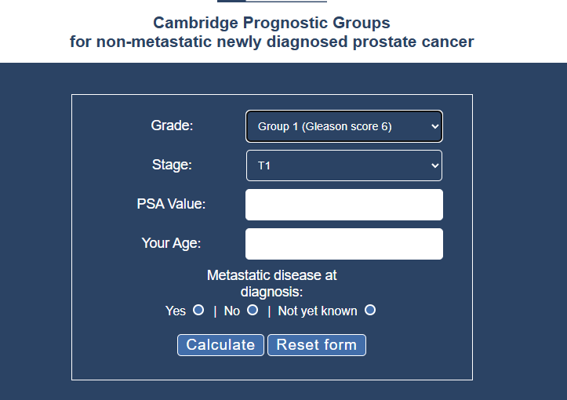
Cambridge Prognostic Group (CPG)

Slide 35
Other definition anomalies
pT1 Endometrial cancer
Most differentiated thyroid cancer

Slide 36
Conclusions and summary
The industry needs to reconsider its definitions
Progress is incremental with disease subtyping
My input is enjoyable !

